Slide 1

Educational Fun, AI-Enabled Interaction, Leading the Early Childhood English Learning Experience寓教于乐、AI智能交互、引领幼儿英语启蒙教育体验
Human Computer Interface 2024
StoryLingoKids
Speaker: Jishen Lin
2024-04-30

Slide 2
StoryLingoKids Development Team
Name | ID | Division of Work
李沅衡 | 2253551 | Documentation Writing, Art Design
林继申 | 2250758 | Framework Construction, Technical Development Slides Production, Art Design
张泰宇 | 2056174 | Documentation Writing, Art Design
王麒懿 | 2252090 | Technical Development, Art Design
GitHub Repository: https://github.com/MinmusLin/Story_Lingo_Kids

Slide 3
1
Background and Motivation
2
Related Work
3
Project Goals
Contents
4
Technology Stack
5
Work Plan
6
Significance and Challenges

Slide 4

01
Background and Motivation

Slide 5
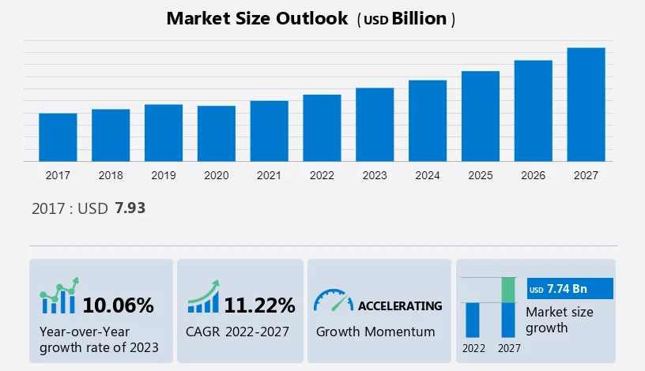
Background and Motivation
1.1 The Early Education Market Size is Expanding Year by Year
Policy Support
Economic Improvement
Demographic Changes
Social Competitive
Pressure
Shift in Parent
Education Perceptions
Technological Integration
and Innovation

Slide 6

Background and Motivation
1.2 Social Pain Points Analysis (Design Background)
Parents are too busy to devote sufficient time to personally educate their children
English enlightenment apps on the market have a single interaction model, lacking appeal for young children
Parents observe a lack of personalized learning paths in current English enlightenment education apps
Parents lack professional resources for early childhood English education

Slide 7
02
Related Work

Slide 8
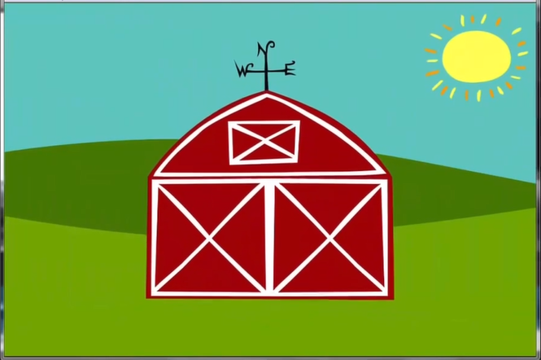
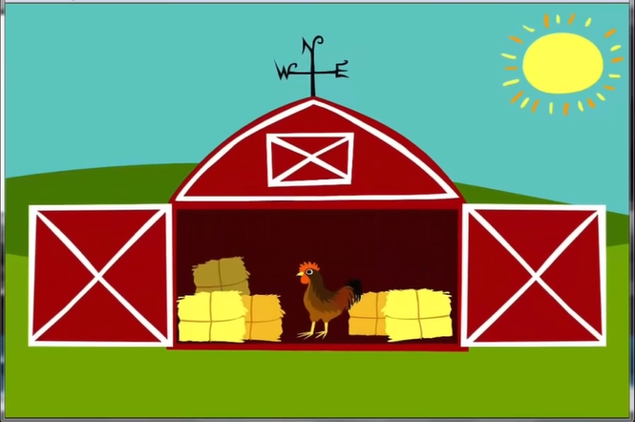
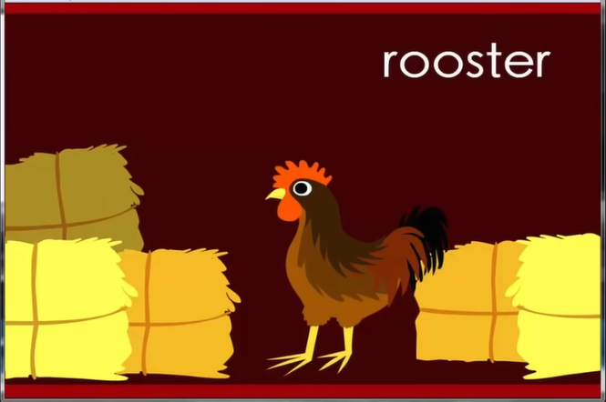
Related Work
2.1 Related Products: Peekaboo Barn – Engaging Toddlers with Interactive Learning
Primary Goal
Introduce young children to farm animals and their sounds through interactive play.
Interactivity
Children tap on the barn doors to reveal the animals inside, learning animal names and sounds.
Colorful Graphics
Vibrant and child-friendly graphics designed to capture the attention of young learners.
Auditory and
Visual Recognition
Helps children associate animal sounds with their corresponding visuals, enhancing memory and recognition skills.

Slide 9


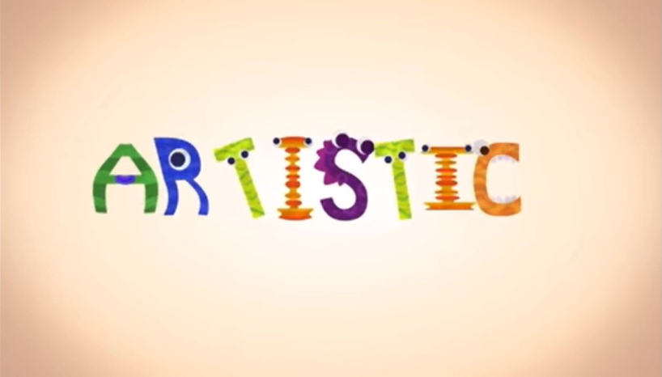
Related Work
2.2 Related Products: Endless Alphabet - Making Learning Fun!
Primary Goal
Teach letters and vocabulary through interactive methods.
Interactivity
Children drag letters into the correct positions to spell words.
Animations
and Sound
Each word is accompanied by a fun animation and clear pronunciation to enhance memory.
Visual and
Auditory Learning
Optimized for visual and auditory memory, helping children better understand and remember new words.

Slide 10
Related Work
2.3 Drawbacks of Existing Products
Rigid Integration of Education and Recreation
Interactivity Restrictions
Limited to simple touch and tap interactions, these apps miss out on more engaging options like multi-touch or voice commands, restricting children's interactive experiences.
Apps typically struggle to balance educational depth with entertainment, either focusing on learning too heavily or focusing too much on gaming aspects.
01
03
02
04
Lack of Diversity
Low Personalization
Apps often focus only on basic skills like animal names or colors, lacking varied and comprehensive educational content for young children.
Most apps fail to tailor content to individual children's behaviors and preferences, particularly neglecting those with special needs by offering uniform learning materials.

Slide 11
Related Work
2.4 Characteristics of Toddler Interaction
01
Intuitive and Sensory-Driven
Bright, simple visuals and sounds enhance focus and interaction.
02
Simple and Clear Operations
Large buttons and easy drag-and-drop actions suit their limited dexterity.
03
Emotional Engagement and Encouragement
Positive feedback from characters and mascots boosts fun and emotional connection.

Slide 12
Related Work
2.5 Design Point
Simple Design
1
Customizability
8
2
Sound Feedback
Guided Learning
7
Key Points of HCI Design for kids
3
Bright Colors
Attract Attention
Educational Content
6
4
Safe Design
5
Interactive Elements

Slide 13
03
Project Goals

Slide 14
Project Goals
Project Design Objectives
Educational Fun
AI-Enabled Interaction
Leading the Early Childhood English Learning Experience
StoryLingoKids
Guiding language learning through stories, specifically designed for kids

Slide 15
Project Goals
01
02
03
Innovative Interaction Methods
Smart Voice Interaction
Personalized Learning Paths
The app combines storytelling with gamification elements to create a contextual learning environment, allowing children to naturally learn English while engaging with the storyline. This method not only makes learning more enjoyable but also enhances the absorption and understanding of the educational content.
Utilizing advanced voice recognition technology, children can practice speaking English by conversing with the app. This interactive mode makes learning more dynamic and appealing, while also providing instant pronunciation correction and real-time feedback, greatly enhancing learning efficiency.
The app's algorithms can customize learning pathways based on each child's progress and interests. By analyzing children's interactions and learning behaviors, the system can offer content that suits their learning level and preferences, ensuring that each child can learn at their own pace, thus maximizing learning outcomes.

Slide 16
04
Technology Stack

Slide 17




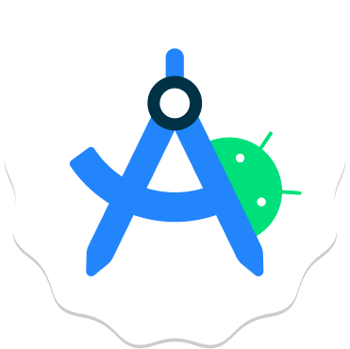



Technology Stack
Flutter
Git
Flutter is an open-source UI software development kit created by Google for building natively compiled applications for mobile, web, and desktop.
Distributed version control system that facilitates code sharing and collaboration.
Dart
GitHub Desktop
Dart is an open-source programming language developed by Google, optimized for building web, server, and mobile applications.
User-friendly interface for managing Git repositories, simplifying version control tasks.
Android Studio
Adobe Photoshop
Official IDE for Android, enhancing developer productivity with advanced coding and testing tools.
Premier software for editing and enhancing digital images and graphics.
Android SDK
Adobe Illustrator
Essential tools and APIs for building, testing, and debugging Android applications.
Vector graphics editor perfect for creating scalable design elements and illustrations.

Slide 18
05
Work Plan

Slide 19
Work Plan (Gantt)
Planning Phase
Design Phase
Development Phase
Testing and Evaluation Phase
Timeline | Week 10 | Week 11 | Week 12 | Week 13 | Week 14 | Week 15 | Week 16 | Week 17
Planning
Requirement Research
Framework Construction
Interaction Interface Design
Develop Interface
Develop Voice Interaction
Develop Personalized Learning Path
Software Testing
Interaction Evaluation

Slide 20
06
Significance and Challenges

Slide 21
Significance and Challenges
6.1 Significance
Children
Parents
Government
Engage in English language learning and enhancement of language skills and creativity through smart, innovative interactions.
Reduce educational burdens, provide tracking of learning progress, and support with home education resources.
Lighten students' learning burdens, push for modernization of education.
Society
Environment
Partners and Investors
Promote fair distribution of educational resources, support comprehensive development of children.
Reduce consumption of paper resources through digital learning, promoting sustainable development in the educational sector.
Invest in the promising field of educational technology, enjoying both economic and social returns, and share in the success of the product.

Slide 22
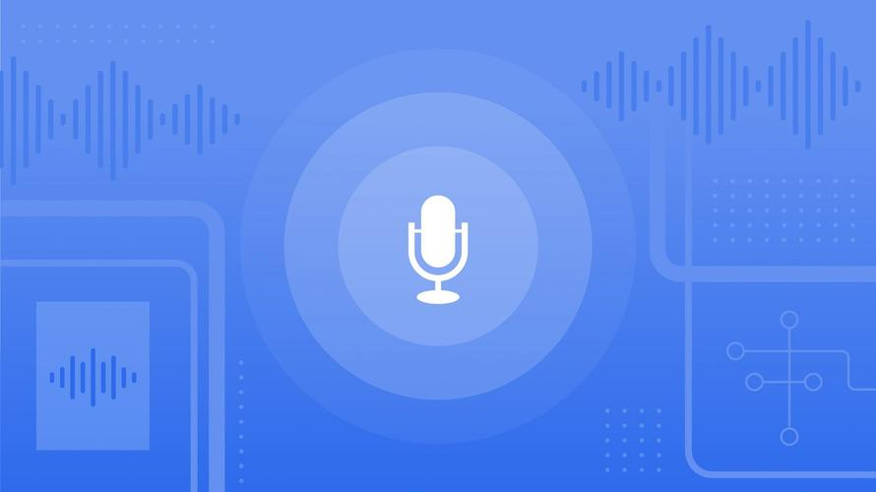

Significance and Challenges
6.2 Challenges
Speech Recognition
Android Studio
Ensuring accurate recognition of children's language through rigorous training and testing of speech recognition models.
Our team needs to quickly learn and adapt to Android Studio, an unfamiliar development environment, to efficiently design user interfaces.

Slide 23
Human Computer Interface 2024
StoryLingoKids
Speaker: Jishen Lin
Educational Fun, AI-Enabled Interaction, Leading the Early Childhood English Learning Experience寓教于乐、AI智能交互、引领幼儿英语启蒙教育体验
2024-04-30

